Slide 1
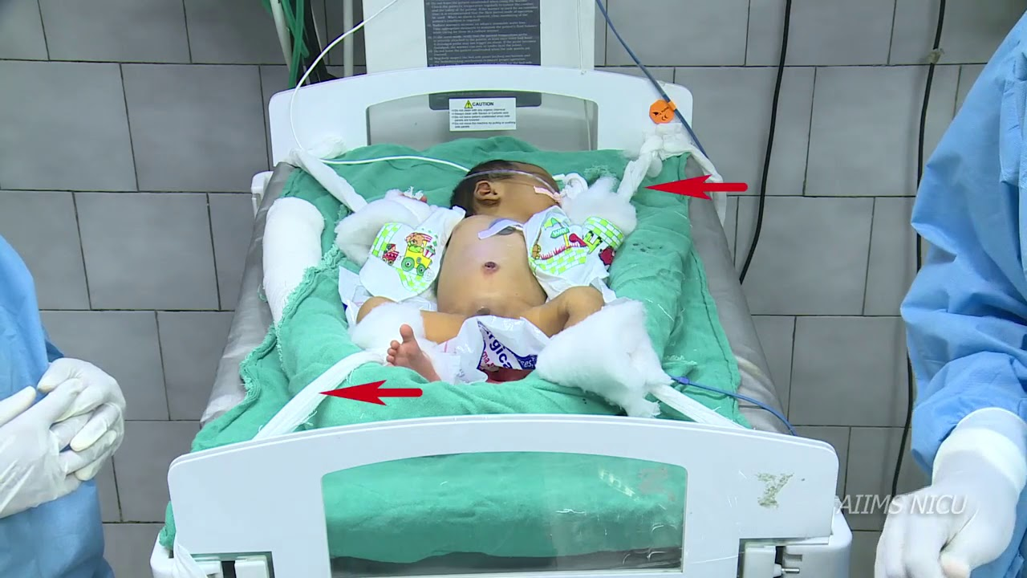
AUTOMATED NEONATAL EXCHANGE TRANSFUSION

Slide 2



GROUP MEMBERS
Bandoma Gideon
8273719
Ameyaw Arthur Samuel
8272619
Cann Josephine
8274419

Slide 3
Outline
Background
Exchange Transfusion
Problem Statement
Various ANETS
Significance

Slide 4
Background
Blood-related issues such as jaundice, hyperbilirubinemia, and hemolytic disease are present in the newborns
In Ghana these blood diseases are predominant.

Slide 5

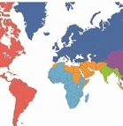
Statistics of Hyperbilirubinemia occurrence
over 60%
of term infants
80%
of preterm infants

Slide 6
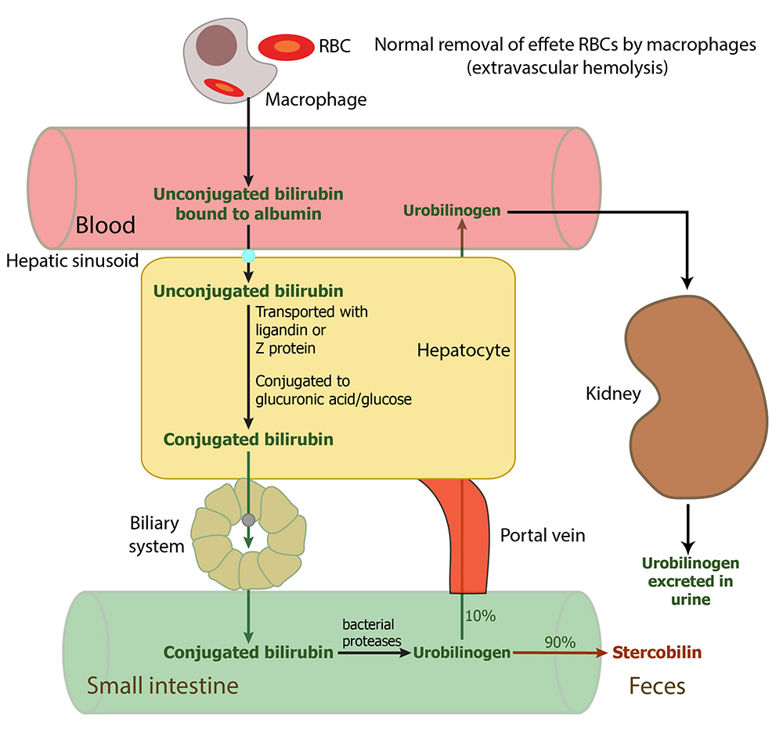
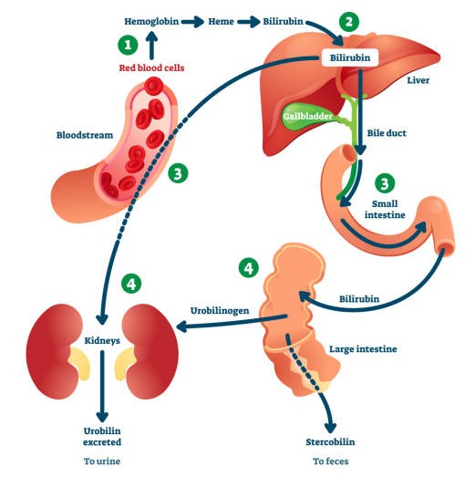
Background
Fe
protoporphyrin

Slide 7
Background
Early detection may be difficult due to:
Visibility of skin
Degree of prediction
Pigment of the eye

Slide 8
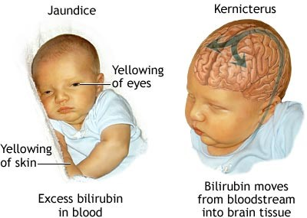
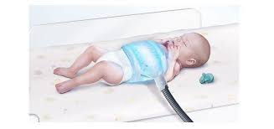
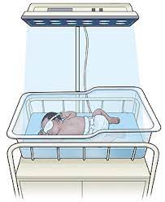
Background
lack the devices for early detection like bilirubin meters used in other countries.
Severe cases lead to brain damage or neurodevelopmental issues
Other Interventions
The aim of this project would be to reduce human interaction when exchange transfusion takes place.

Slide 9
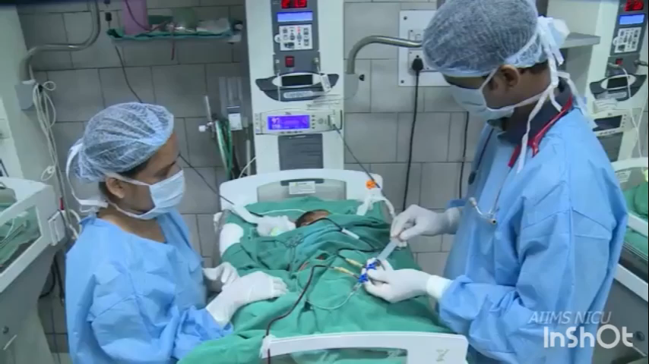
Exchange Transfusion
Slow withdrawal of blood usually through catheters inserted into a blood vessel
replacing it with fresh blood from a donor
Two techniques for the blood exchange transfusion
Single catheter
double catheter

Slide 10
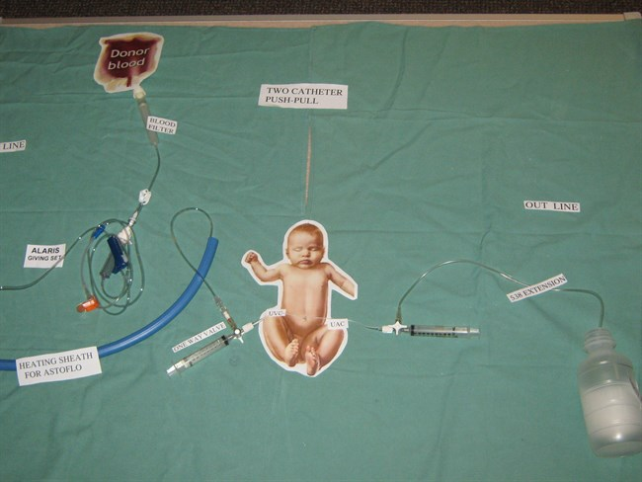
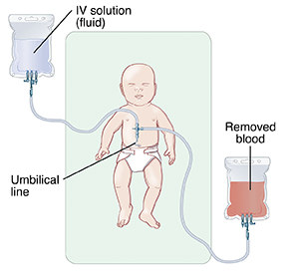
Single Catheter
Double Catheter

Slide 11
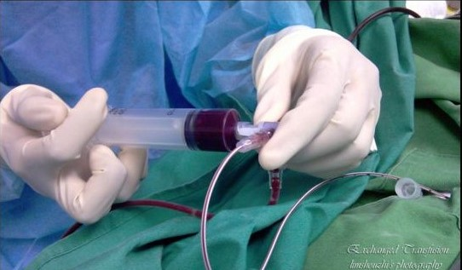
Problem Statement
ET is a very tedious and time-consuming process.
This makes the procedure although a life-saving one seem unappealing

Slide 12
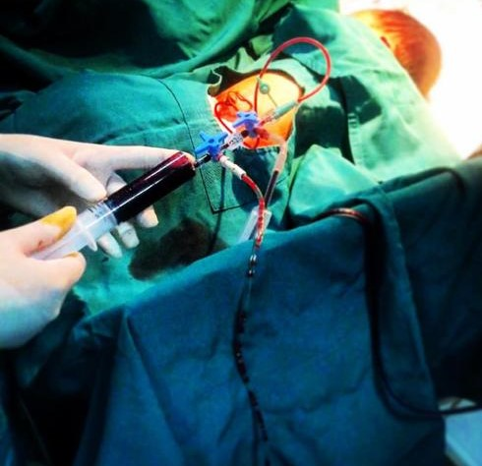
Problem
ET must be performed slowly and steadily in cycles
Thus avoids iron overload, which can cause damage to the heart, liver, and other organs
Very tedious and human-prone to errors
Consumes precious time for clinicians

Slide 13

Objectives
Automate the process.
Using classical electronics to improve the plunging effects.
Device would make it less time-consuming and less prone to errors
Low-cost device
Add an alarm system

Slide 14
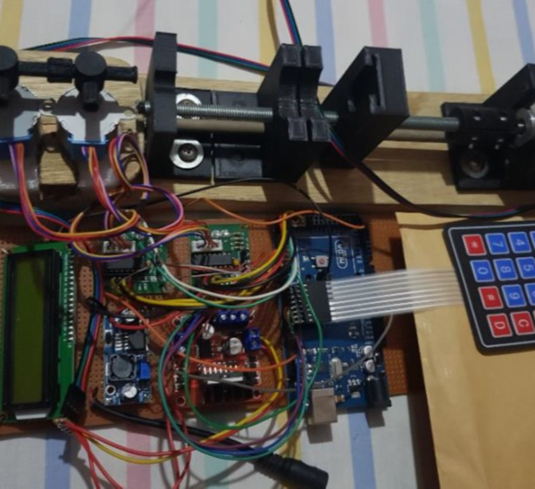
ANET 1.0

Slide 15
ANET 1.0
CHALLENGES
Wobbling effects
Overheating unnecessary noise
Air bubbles
air bubbles being trapped in the device 3D-printed valves
AIMS
To automate the process
Replaced manual pumping of the syringe
Replaced manual control of the valves with motors

Slide 16
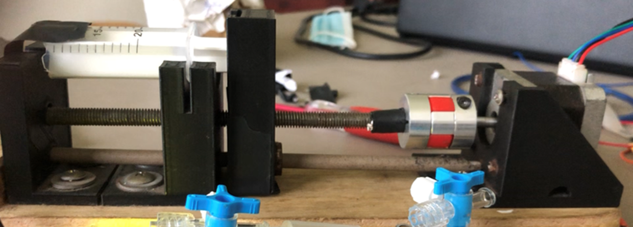
ANET 2.0

Slide 17
ANET 2.0
AIMS
Replaces manual turning-off valves
Uses motors controlled by a program written to the microcontroller
Designing new valves specifically to fit the design
Design new coupling for motors
Replacing the motors with higher torque motors
CHALLENGES
Heparin pump
Monitoring system for the blood circuit
Valve turns
Plunging effect

Slide 18
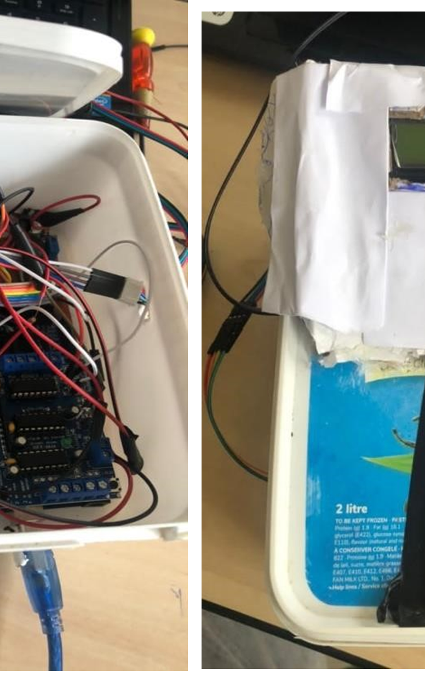
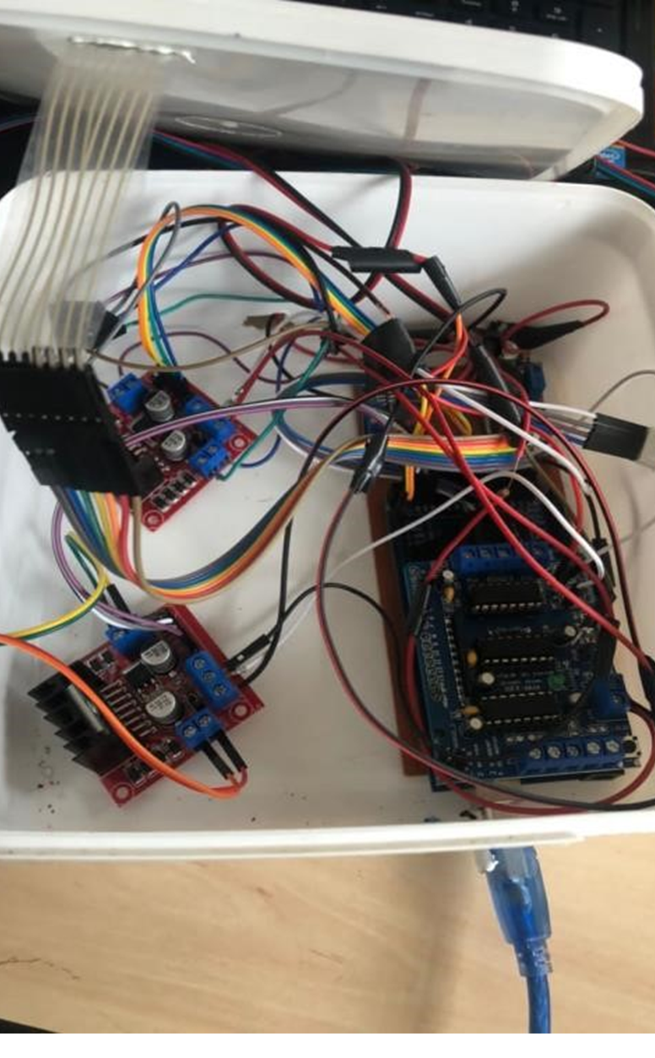
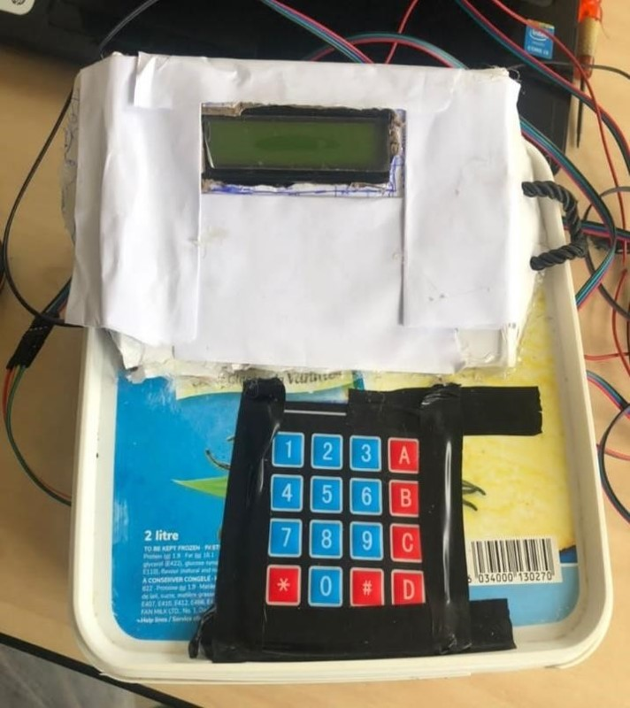
ANET 3.0

Slide 19
ANET 3.0
CHALLENGES
Not enough torque to turn valves:
valves were designed to be turned manually by hand and therefore overburden the unipolar stepper motors employed
AIMS
To automate the process and solve ANET 2.0 issues
Wobbling effects
Overheating
Air bubbles

Slide 20
What’s new in ANET 4.0
Improve plunging effects using classical electronics.
Adding an alarm system.
Provide adequate power possibly using the mains.
Improve on the turns on the valves

Slide 21
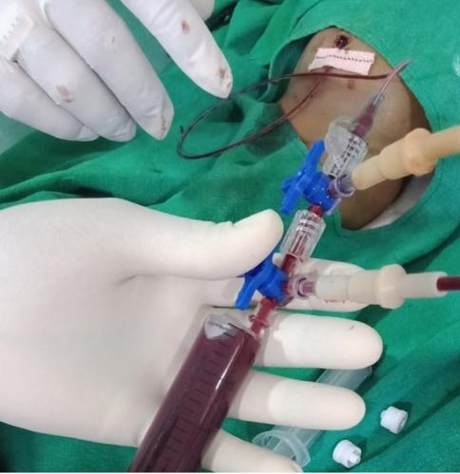
SIGNIFICANCE OF PROJECT
Less human-dependent device
Higher guarantee for consistency, accuracy, efficiency, and fewer human errors.
Relief to doctors and health workers.
All at a moderate cost

Slide 22
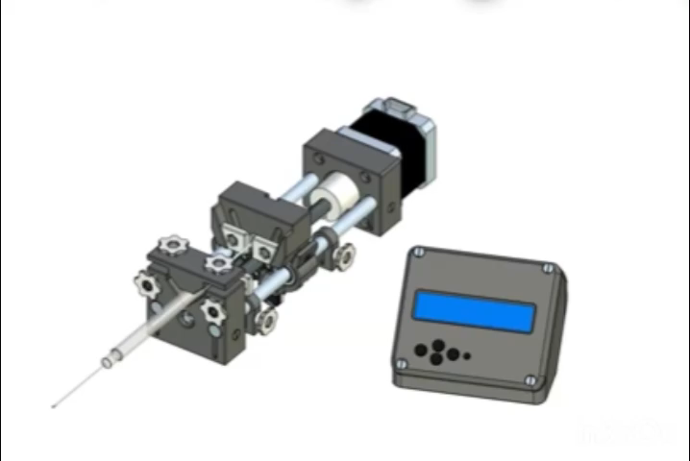
WORK SO FAR
We have started creating 3D models which would be used in simulating the operation of the ANET
We have installed LabView and taken an online course in using it.
We have also taken a course on how to use EndNote.
Enquiries on the lab subject test

Slide 23


